Slide 1
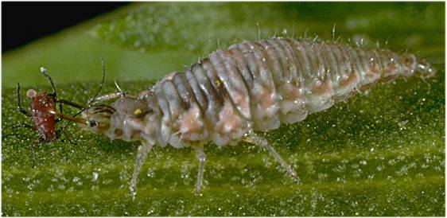
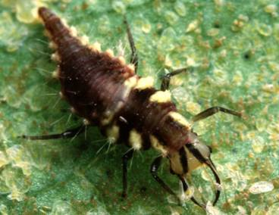
077 Lacewing larva
Neuroptera
Holometabolous
Chewing
Beneficial

Slide 2
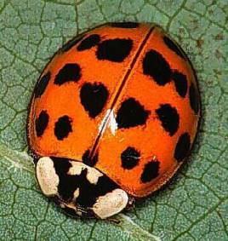
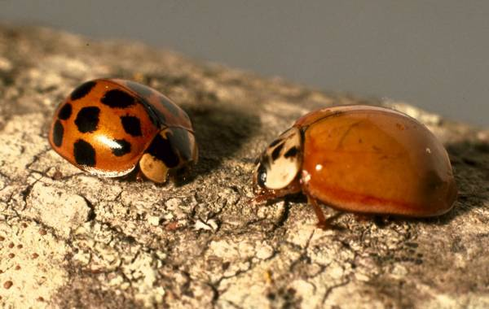
078 Ladybird beetle
Coleoptera
Holometabolous
Chewing
Beneficial

Slide 3
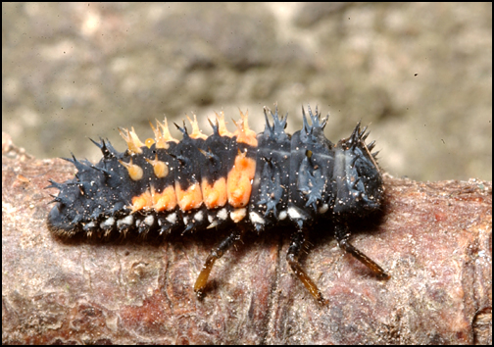
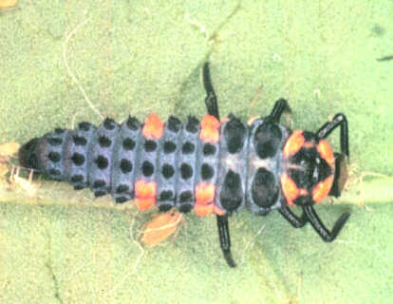
079 Ladybird beetle larva
Coleoptera
Holometabolous
Chewing
Beneficial

Slide 4
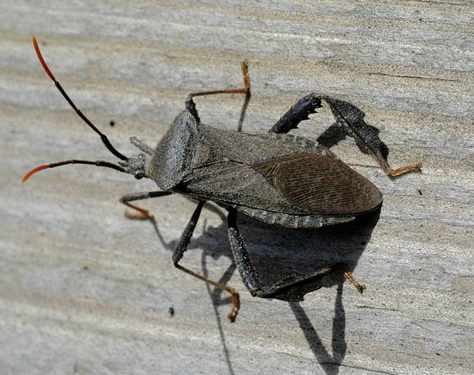
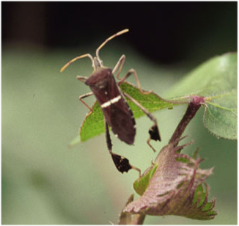
080 Leaf-footed bug
Hemiptera
Hemimetabolous
Piercing-sucking
Pest

Slide 5
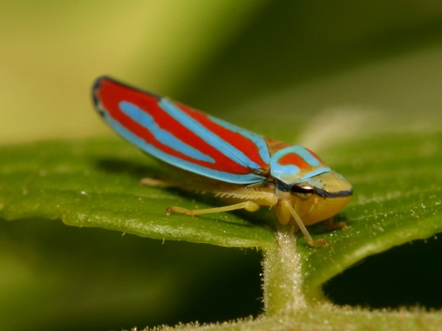
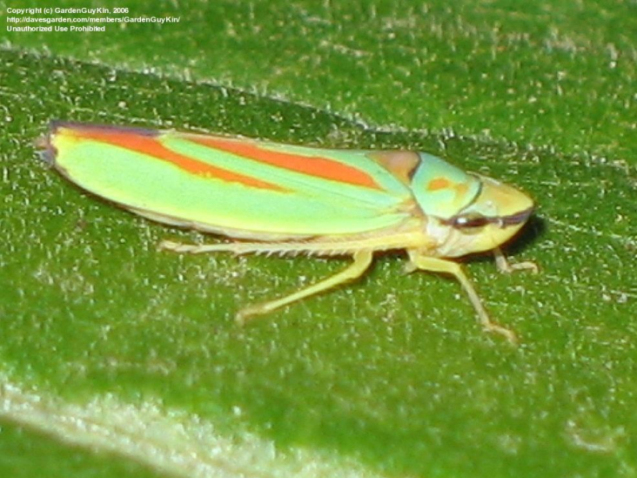
081 Leafhopper
Hemiptera
Hemimetabolous
Piercing-sucking
Pest

Slide 6
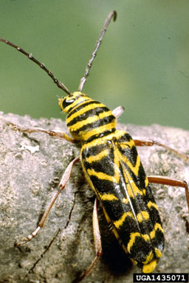
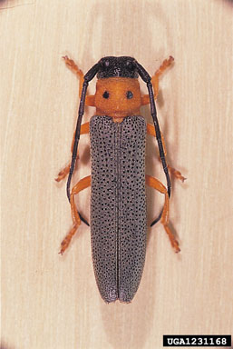
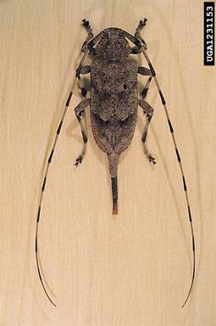
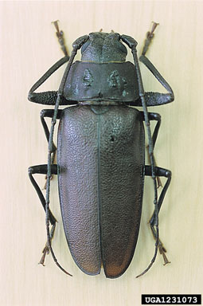
082 Longhorned beetle
Coleoptera
Holometabolous
Chewing
Pest

Slide 7
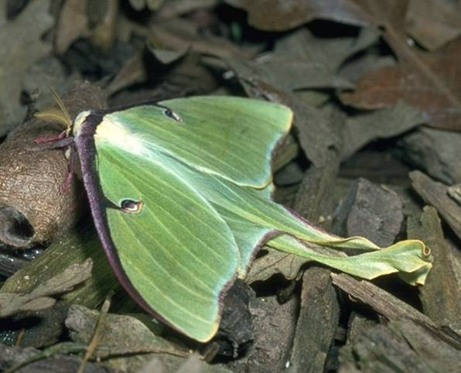
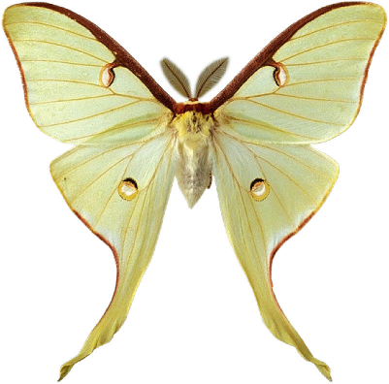
083 Luna moth
Lepidoptera
Holometabolous
Siphoning
Beneficial

Slide 8
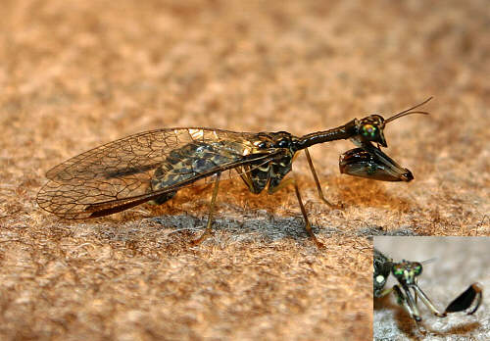
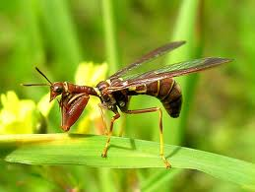
084 Mantidfly
Neuroptera
Holometabolous
Chewing
Beneficial

Slide 9
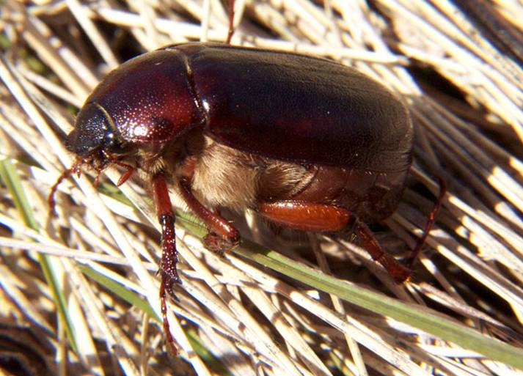
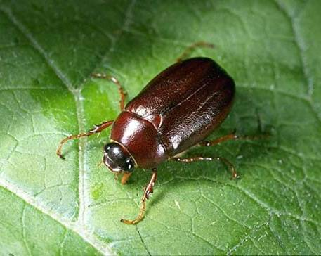
085 May beetle
Coleoptera
Holometabolous
Chewing
Pest

Slide 10
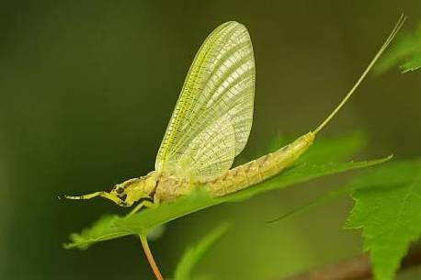
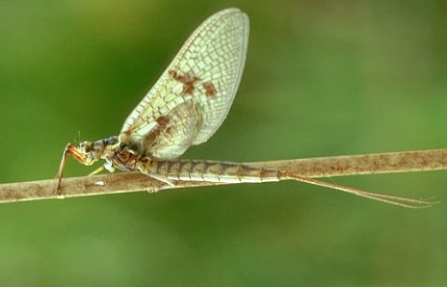
086 Mayfly
Ephemeroptera
Hemimetabolous
Vestigial
beneficial
IN glass vial

Slide 11
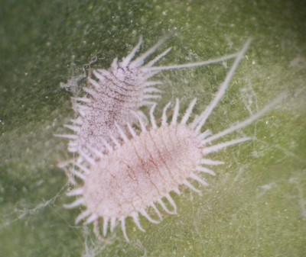
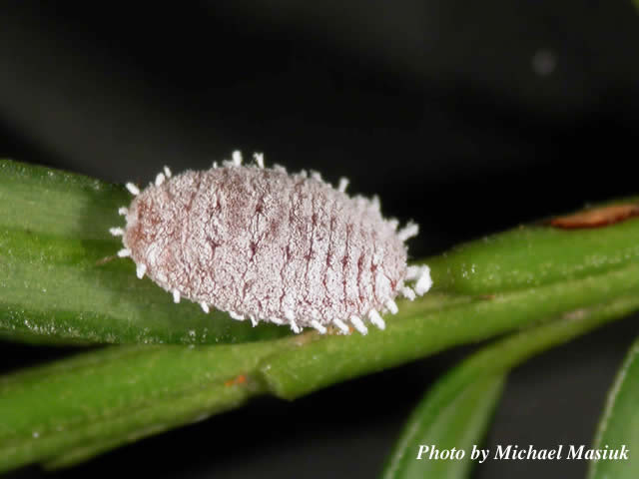
087 Mealybug
Hemiptera
Hemimetabolous
Piercing-sucking
Pest

Slide 12
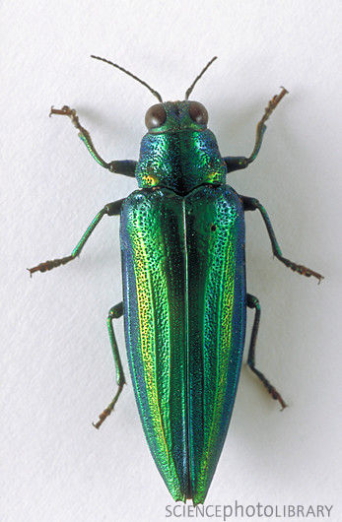
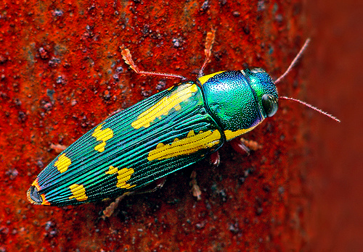
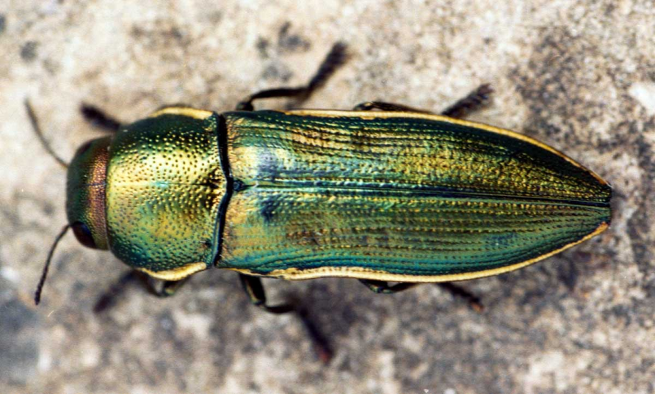
088 Metallic wood boring beetle
Coleoptera
Holometabolous
Chewing
Pest

Slide 13
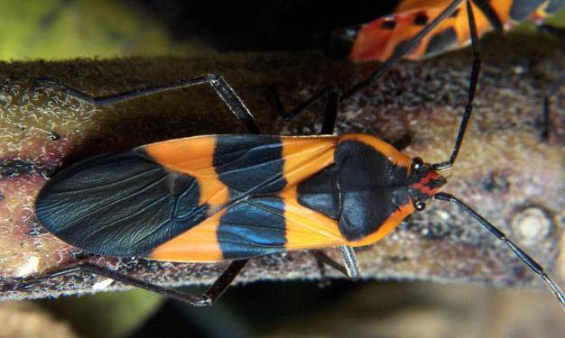
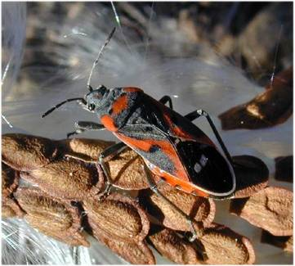
089 Milkweed bug
Hemiptera
Hemimetabolous
Piercing-sucking
Pest

Slide 14
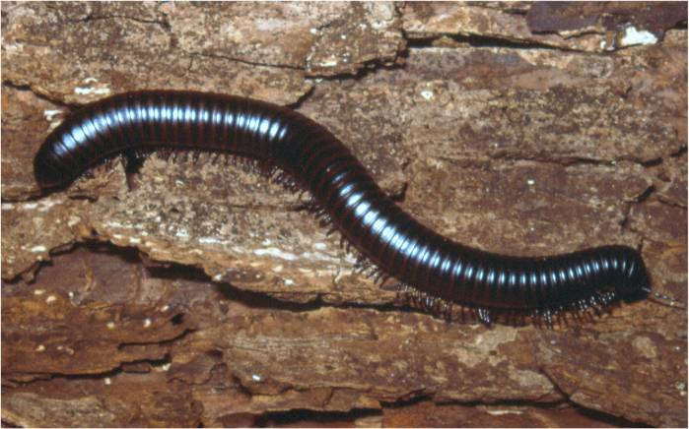
090 Millipede
Non-insect
Chewing
Beneficial

Slide 15
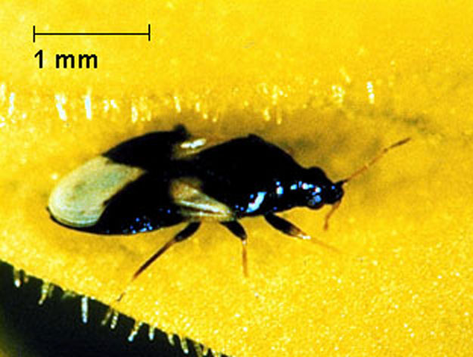
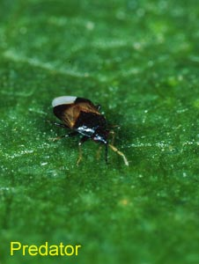
091 Minute pirate bug
Hemiptera
Hemimetabolous
Piercing-sucking
Beneficial

Slide 16
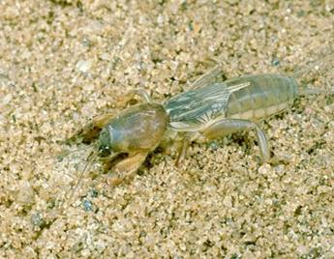
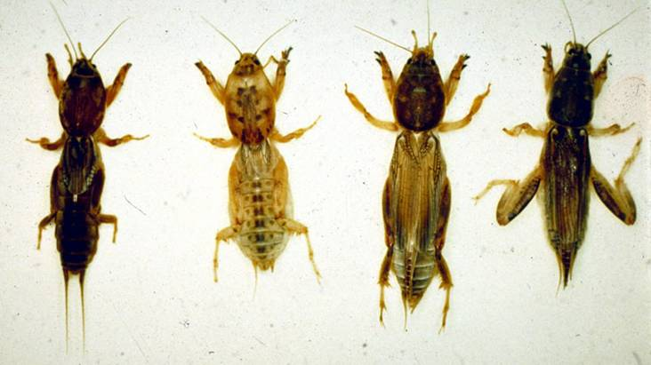
092 Mole cricket
Orthoptera
Hemimetabolous
Chewing
Pest

Slide 17
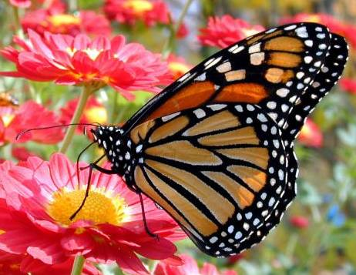
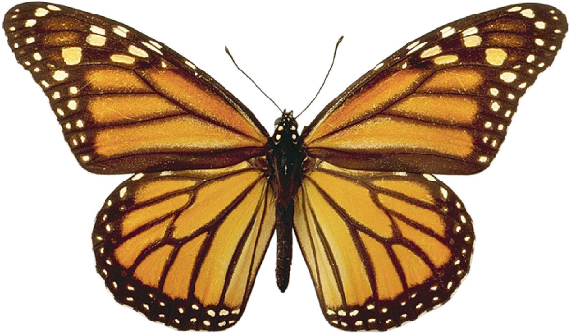
093 Monarch butterfly
Lepidoptera
Holometabolous
Siphoning
Beneficial

Slide 18
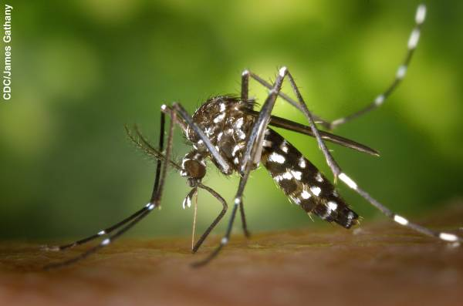
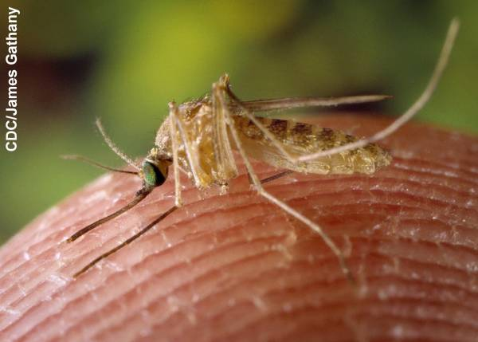
094 Mosquito
Diptera
Holometabolous
Piercing-sucking
Pest

Slide 19
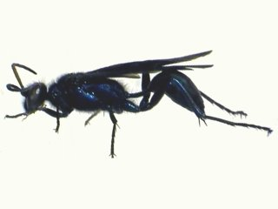
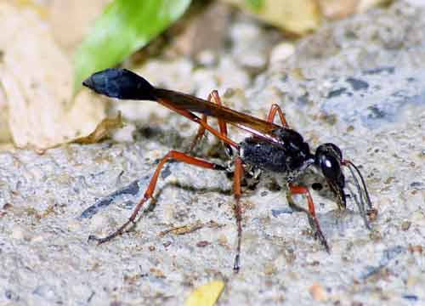
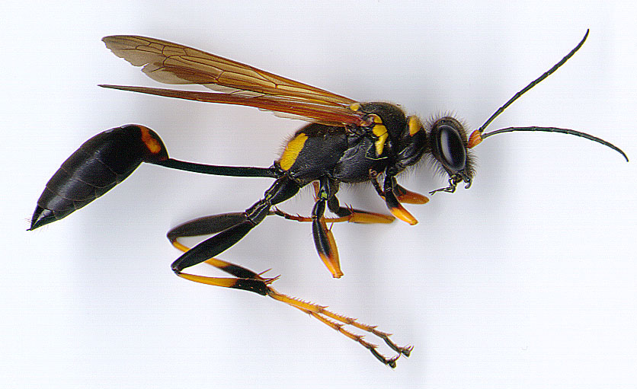
095 Mud-dauber wasp
Hymenoptera
Holometabolous
Chewing
Variable

Slide 20
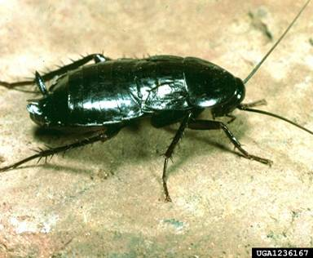
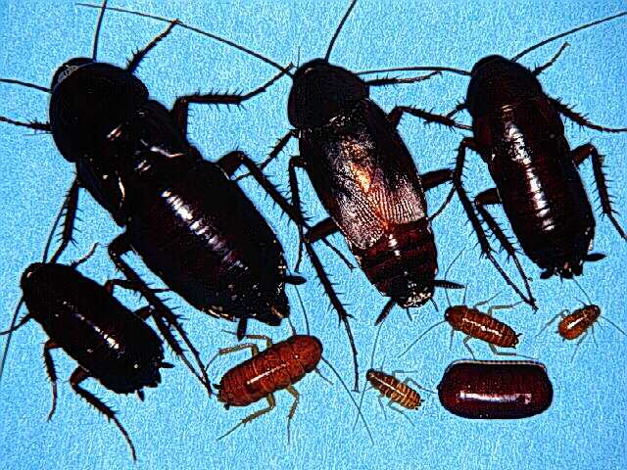
096 Oriental cockroach
Blattodea
Hemimetabolous
Chewing
Pest

Slide 21
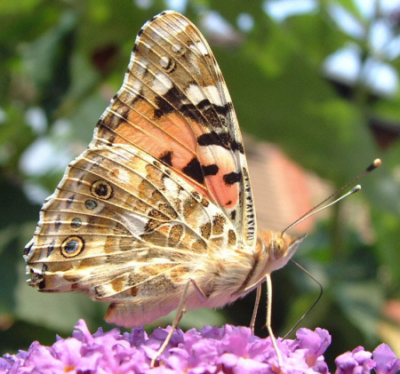
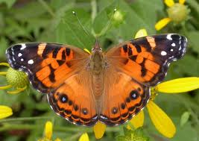
097 Painted lady
Lepidoptera
Holometabolous
Siphoning
Beneficial

Slide 22
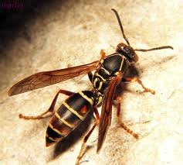
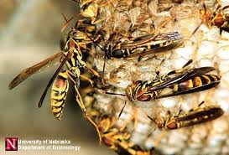
098 Paper wasp
Hymenoptera
Holometabolous
Chewing
Variable (Pest and Beneficial)

Slide 23
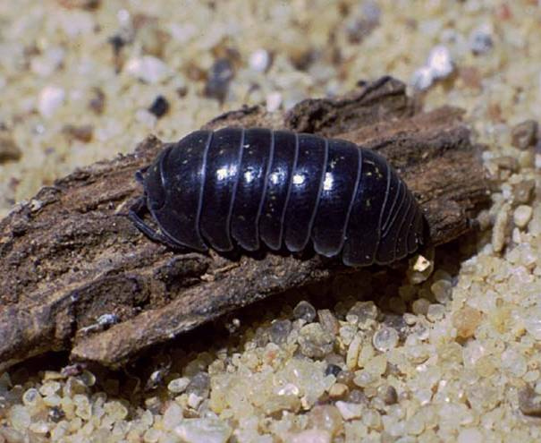
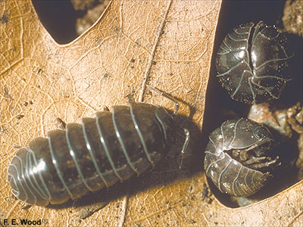
099 Pillbug
Non-insect
Chewing
Variable (Pest and Beneficial)

Slide 24
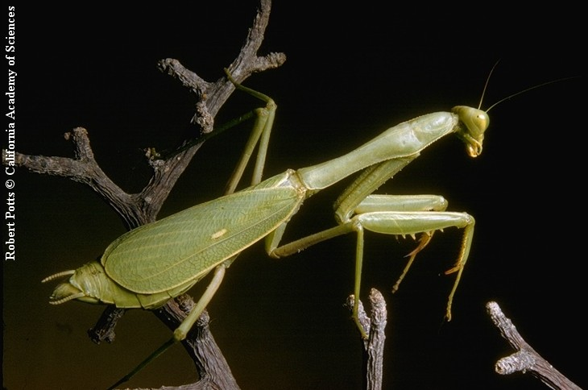
100 Praying mantis
Mantodea
Hemimetabolous
Chewing
Beneficial

Slide 25
101 Predaceous diving beetle
Coleoptera
Holometabolous
Chewing
Beneficial

Slide 26
102 Red admiral
Lepidoptera
Holometabolous
Siphoning
Beneficial

Slide 27
103 Red flour beetle
Coleoptera
Holometabolous
Chewing
Pest

Slide 28
104 Red harvester ant
Hymenoptera
Holometablous
Chewing
Pest

Slide 29
105 Red imported fire ant
Hymenoptera
Holometablous
Chewing
Pest

Slide 30
106 Rice Weevil
Coleoptera
Holometabolous
Chewing
Pest

Slide 31
107 Robber fly
Diptera
Holometabolous
Piercing-sucking
Beneficial

Slide 32
108 Rove beetle
Coleoptera
Holometabolous
Chewing
Beneficial

Slide 33
109 Sawtoothed grain beetle
Coleoptera
Holometabolous
Chewing
Pest
Note Jagged Edged Thorax

Slide 34
110 Scorpion
Non-insect
Pest

Slide 35
111 Scorpionfly
Mecoptera
Holometabolous
Chewing
Beneficial

Slide 36
112 Silverfish
Thysanura
Ametabolous
Chewing
Pest

Slide 37
113 Skipper butterfly
Lepidoptera
Holometabolous
Siphoning
Variable (Pest and Beneficial)
Notice the Large Eyes

Slide 38
114 Snakefly
Neuroptera
Holometabolous
Chewing
Beneficial

Slide 39
115 Soft scale
Hemiptera
Hemimetabolous
Piercing-sucking
Pest

Slide 40
116 Soldier beetle
Coleoptera
Holometabolous
Chewing
Beneficial
Notice Orange Thorax

Slide 41
117 Southwestern corn borer
Lepidoptera
Holometabolous
Chewing
Pest

Slide 42
118 Sphinx moth
Lepidoptera
Holometabolous
Siphoning
Variable (Beneficial and Pest)

Slide 43
119 Spider mite
Non-insect
Piercing-sucking
Pest
8 legs

Slide 44
120 Spinose ear tick
Non insect
Piercing-sucking
Pest

